Slide 1
DataStax Enterprise 6 Solution Day

Slide 2
Agenda

Slide 3
Topology and Architecture
Notes:
Now I’d like to show you Cassandra in action and what that experience is like, working with CQL in DataStax Enterprise

Slide 4
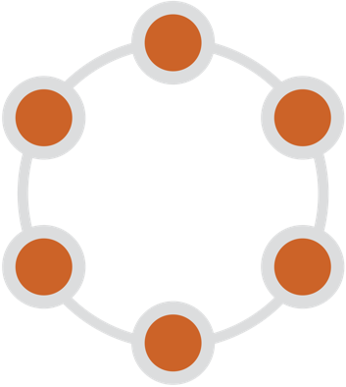
Terminology
Node: A single instance
Datacenter: A logical grouping of racks or nodes
Cluster: A logical grouping of data centers (1 to N)
Cluster
Racks
DC1
DC2
Notes:
Let’s start digging into some of the details of why Cassandra is a solid foundation for our data layer.
We’ll introduce some of the terminology that we use
A deployment of Cassandra involves multiple nodes – we call this a cluster
Within a cluster we can have logical groupings which represent data centers or racks of equipment

Slide 5
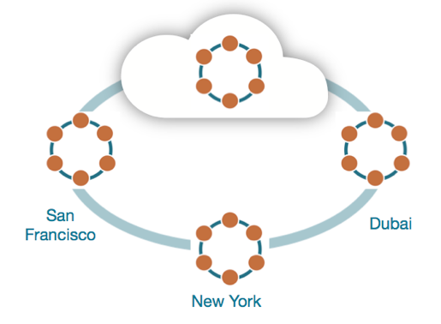
Read/write anywhere
DSE has a ‘location independence’ architecture
Any user can connect to any node in any data center and read/write the data they need
All writes are automatically evenly partitioned/distributed across the nodes and replicated automatically throughout the cluster
Notes:
One of the benefits of this distributed architecture is that we can read or write data any where in the cluster
Client applications can connect to any node and read or write the data they need
When we write data, Cassandra handles the details of spreading multiple copies of the data throughout the cluster

Slide 6
No single point of failure
Best in class fault tolerance
Replication automatically handled
Remains operationally simple at scale
Client
Node fails or goes down temporarily
80
We can still retrieve the data from the other 2 nodes
Notes:
This means that our system has no single point of failure.
Because multiple copies of our data are stored in multiple nodes in each data center, we can survive the failure of a node or even an entire data center and still have the ability to read and write data

Slide 7
Multi-data center
Replicate data across data centers or cloud availability zones
No interruption to the business with any outage
Global low-latency performance
West Client
East Client
East Data Center
Outage
West Data Center
Notes:
Replication works across data centers. I can write data in the east data center if there is an outage, my application can fail over to the west data center.

Slide 8


Flexible deployment options
Public Cloud: Take full advantage of cloud elasticity and global availability. With easy migrations to any and every public cloud provider you’ll never be locked in.
Hybrid: Have the best of both worlds, spanning a single cluster across on-premises and cloud.
On-Prem/Private Cloud: Maintain control of the hardware and the software by running from your own environment.
Hub and spoke: Have a central hub with many spokes. Perfect for intermittent connections, compliance, or optimizing for location needs.
Notes:
DataStax Enterprise supports multiple deployment options.
You can deploy it in your on-premise data center, in public clouds, or hybrid environments
We also support some advanced deployment options such as hub-and-spoke which is great for situations where there is intermittent connectivity between locations.

Slide 9


Linear Scalability
Data partitioned among all nodes in the cluster
Linear scalability (performance / storage)
50,000 trans/sec
500 GB
100,000 trans/sec
1 TB
200,000 trans/sec
2 TB
Notes:
Cassandra demonstrates true linear scalability, which might be its killer feature.
You can achieve higher throughput on reads and writes just by adding nodes. Other databases don’t demonstrate this property

Slide 10
Balancing replication and consistency
Replication Factor (RF)
Determines how many nodes in the replica must
Highly configurable for SLA & network topology (racks, data centers)
Consistency Level – CL
Specifies how synchronized a row of data must be across C* nodes
Tunable consistency: client application decides CL for each operation
CREATE KEYSPACE "Excalibur” WITH REPLICATION={'class' : 'NetworkTopologyStrategy', 'DC1' : 3, 'DC2' : 3};
LOCAL_ONE … ONE … LOCAL_QUORUM … QUORUM … EACH_QUORUM … ALL
Notes:
Cassandra also gives you a lot of flexibility in managing the tradeoffs that you need in distributed systems.
For example, we have the concepts of replication factor and consistency level
The replication factor is how you tell Cassandra how many copies or replicas of your data you want kept in each data center
The consistency level describes how many of those nodes need to respond in order for a write or read to be successful

Slide 11
Tunable Consistency
Notes:
Now I’d like to show you Cassandra in action and what that experience is like, working with CQL in DataStax Enterprise

Slide 12
Data Replication
N0
Incoming requests (read/write)
Coordinator node handles the request
N5
N1
Application
CQL Driver
request
N4
N2
coordinator
N3
CREATE KEYSPACE dsbank
WITH replication = {
'class': 'NetworkTopologyStrategy‘,
'DC1': ‘3‘
}
Every node can be coordinator → masterless
Notes:
These controls of replication factor and consistency allow us to make tradeoffs between consistency, availability, and performance
We have the flexibility on a per operation basis to state how much consistency we require
If you’re willing to accept a lower consistency level, that means that you’re ok with only hearing from some of the nodes that are responsible for your data, and trust Cassandra to get the other nodes up to date in the background, this is called eventual consistency
This might be a good option in applications that are ingesting a large amount of data quickly

Slide 13
Tunable consistency
Choose between strong and eventual consistency (one to all responding) depending on the need
Can be done on a per-operation basis, and for both reads and writes
Handles multi-data center operations
Light Weight transaction = ACID like
Client
Writes
Reads
Any
One
Local_One
Quorum
Local_Quorum
Each_Quorum
All
One
Quorum
Local_Quorum
Each_Quorum
All
Notes:
These controls of replication factor and consistency allow us to make tradeoffs between consistency, availability, and performance
We have the flexibility on a per operation basis to state how much consistency we require
If you’re willing to accept a lower consistency level, that means that you’re ok with only hearing from some of the nodes that are responsible for your data, and trust Cassandra to get the other nodes up to date in the background, this is called eventual consistency
This might be a good option in applications that are ingesting a large amount of data quickly

Slide 14
Data Modelling Basics
Notes:
Now I’d like to show you Cassandra in action and what that experience is like, working with CQL in DataStax Enterprise

Slide 15
Primary data model
Tabular: similar to an RDBMS table but more flexible/dynamic
Table is partitioned by one or more columns enabling fast lookups by partition keys
Other columns may be indexed as well using secondary indexes, materialized views and DSE Search
Keyspace: similar to a database in the RDBMS world
Portfolio Keyspace
Customer Table
ID | Name | SSN | DOB

Slide 16
Cassandra Query Language (CQL)
Syntax similar to RDBMS SQL
Create objects via DDL
For example:
CREATE, INSERT, UPDATE,
DELETE, GRANT, REVOKE
SELECT, WHERE
CQL Example
CREATE TABLE market_prices ( symbol TEXT, date TIMESTAMP, price DECIMAL,
side INT, PRIMARY KEY (symbol, date) ) WITH CLUSTERING ORDER BY
(date DESC);
Notes:
Cassandra Query Language (CQL) is the primary language for communicating with DSE data management platform. CQL is a SQL-like language and allows you to create keyspace and tables, insert and query tables plus other activities using the language you are already familiar with.

Slide 17
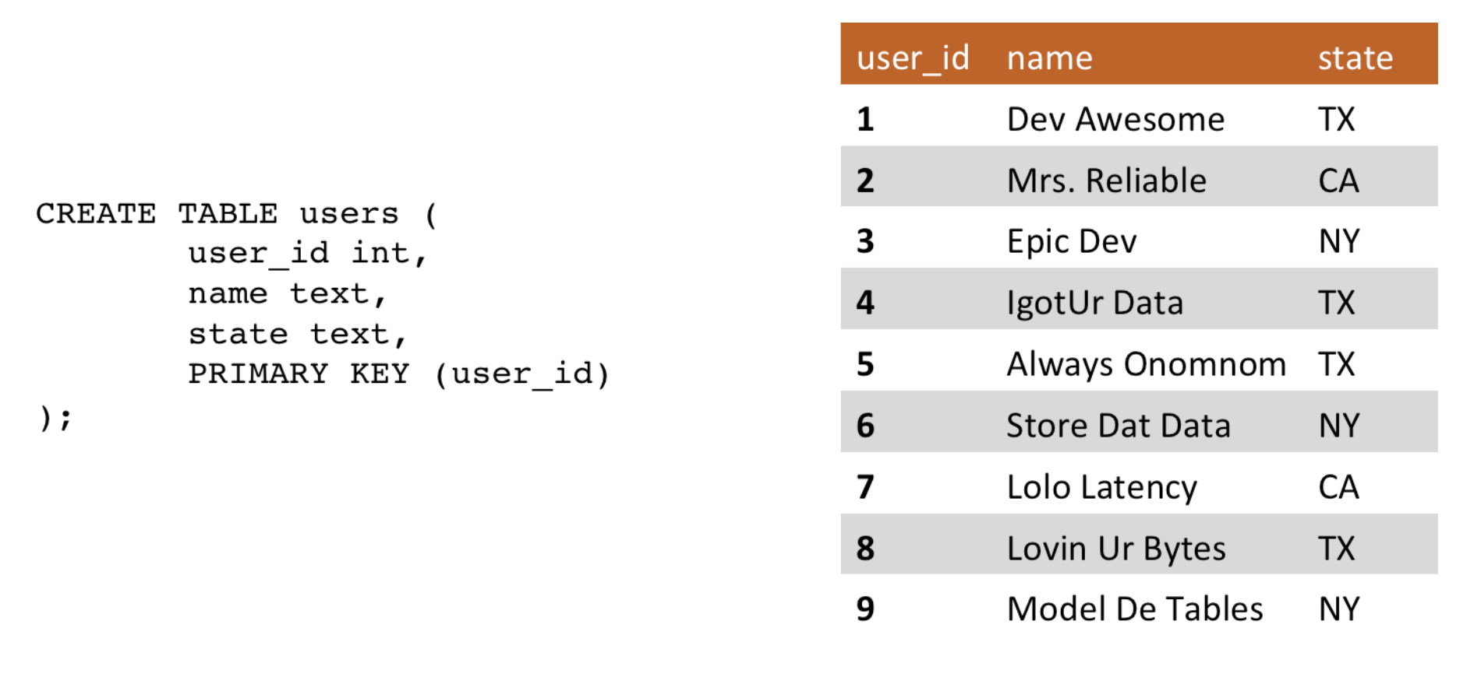
Partitions

Slide 18
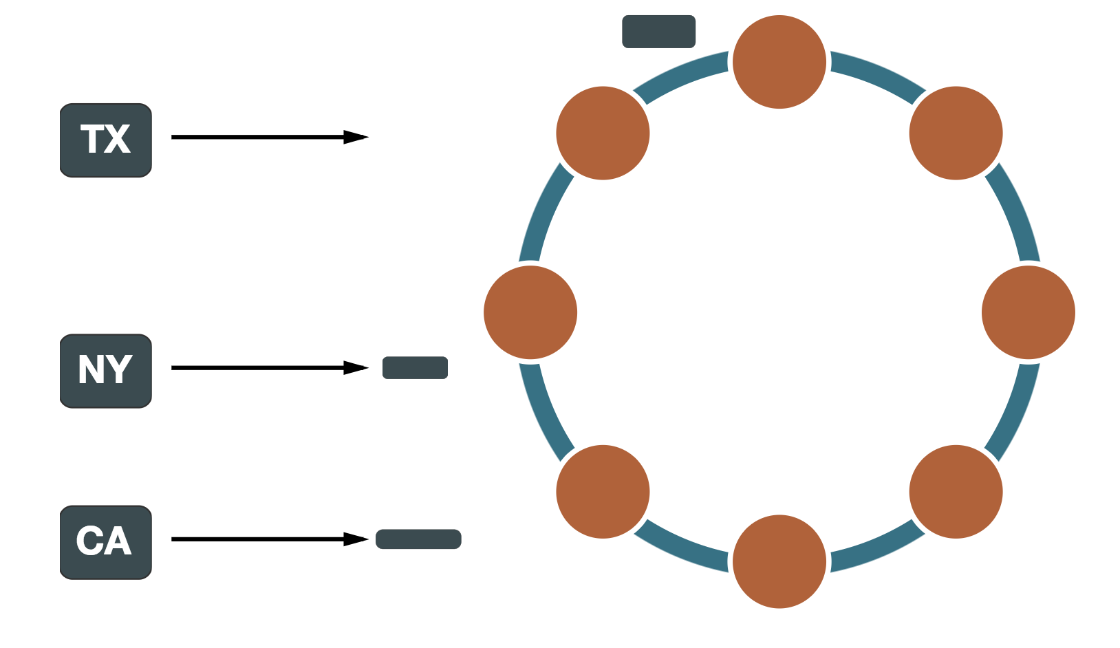
Partitions

Slide 19
Primary Keys
Partition Key
Clustering Columns
Ensures row uniqueness
Defines the location of the partition in the cluster
Hashed to ensure even data distribution
Can be composed of multiple columns
Composite/Compound Key
Sorts data within each partition
Defaults to ascending order
Can consist of multiple columns
PRIMARY KEY ((account_number), transaction_time)

Slide 20
Tokens
Token Range : - 2⁶³ to 2⁶³
Data is partitioned after its partition key
A unique token is allocated to a partition
Token = random hash of #partition (murmer3)
N0
N5
N1
N4
N2
N3
Notes:
Each node “owns” a share of the token ring
It also hosts replicas for other nodes
There is no better or primary replica!

Slide 21
Data Distribution
Token = hash of #partition → #node
N0
Token1
Token2
Token3
Token4
Token4
target_user 1
target_user 2
target_user 3
target_user 4
target_user 5
N5
N1
N4
N2
N3
Data is evenly distributed and clock wise replicated
Notes:
Each node “owns” a share of the token ring
It also hosts replicas for other nodes
There is no better or primary replica!

Slide 22
Automated Data Distribution Sharding
tuser₃
N0
tuser₄
N5
N1
tuser₂
N4
N2
tuser₅
N3
tuser₁
Notes:
Each node “owns” a share of the token ring
It also hosts replicas for other nodes
There is no better or primary replica!

Slide 23
What’s Stored With Each Column?
nick | notification_time: 2017-11-01 10:00 |  | notification_time: 2017-11-02 11:00 |  | notification_time: 2017-11-03 09:00
 | ntfcid: 5321998c | activity: tom liked | ntfcid: ea1c5d35 | activity: jake commented | ntfcid: 5321998c | activity: mike created account
column name : “activity”
column value : “tom liked”
timestamp : 1353890782373000
TTL : 3600
Last Write Win, cross cluster clock sync, e.g NTP

Slide 24
Write Path…
MEMTABLE
3 | Schnack
4 | Bennet
6 | Stupp
8 | Ambridge
3 | Schnack
4 | Vincent
6 | Stupp
8 | Ambridge
Write request
user_id : 4 name : Vincent
custid : 4 name : Vincent
FLUSH
COMMIT LOG
SSTABLE
3, Schnack
4, Bennet
6, Stupp
8, Ambridge
3, Schnack
4, Bennet
6, Stupp
8, Ambridge
4, Vincent
3 : Schnack
4 : Vincent
6 : Stupp
8 : Ambridge
INDEX
IMMUTABLE
ORDERD
user_id : 4 name : Vincent

Slide 25
FLUSH 1
FLUSH 2
FLUSH 3
SSTABLE_SALES_1
SSTABLE_SALES_2
SSTABLE_SALES_3
INDEX
3 : Schnack|t1
4 : Benett |t2
5 : Stupp |t3
INDEX
6 : Hermann |t4
7 : Willhelm|t5
8 : Heinrich|t6
INDEX
9 : Marhoul |t7
4 : Vincent |t8
2 : Ambridge|t9
TIME
INDEX
2 : Ambridge |t9
3 : Schnack |t1
4 : Vincent |t8
5 : Stupp |t3
6 : Hermann |t4
7 : Willhelm |t5
8 : Heinrich |t6
9 : Marhoul |t7
COMPACTION
SSTABLE_SALES_4

Slide 26
Read Path

Slide 27
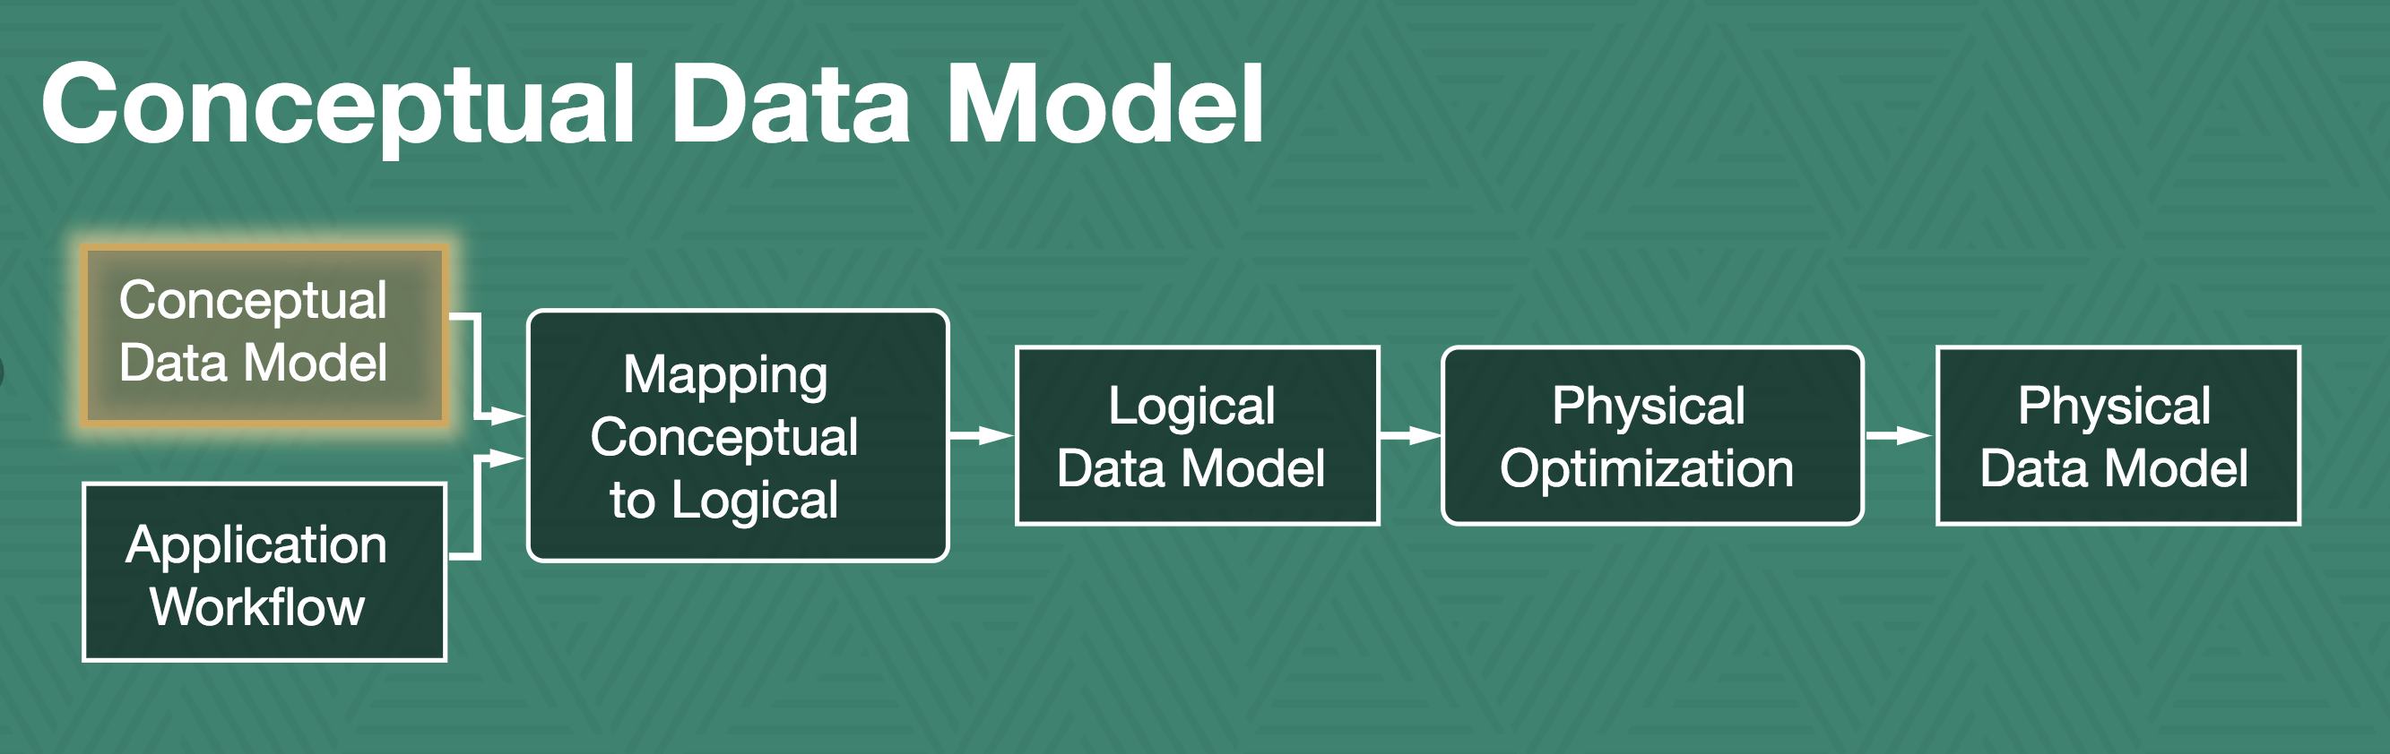
Methodology

Slide 28
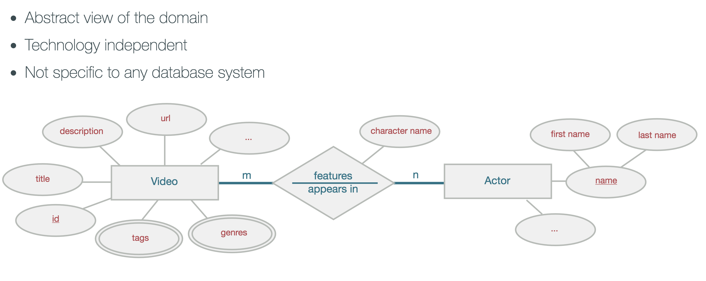
Conceptual Data Model

Slide 29
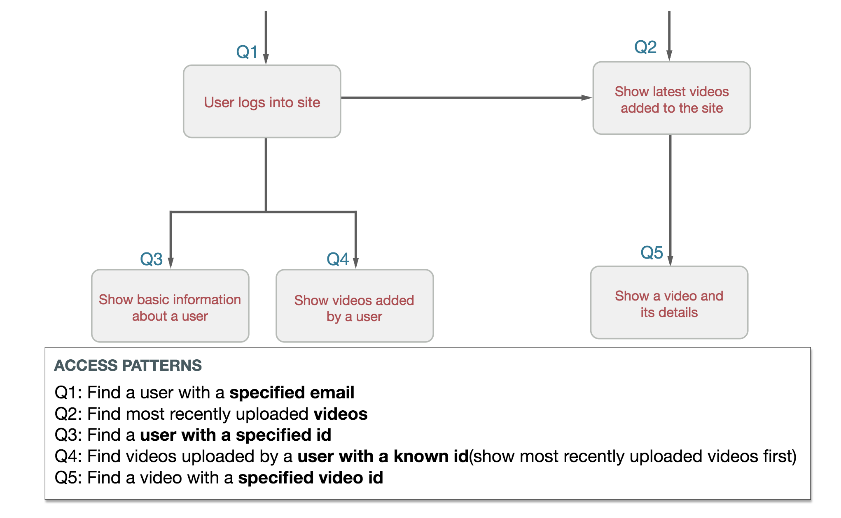
Application Workflow

Slide 30
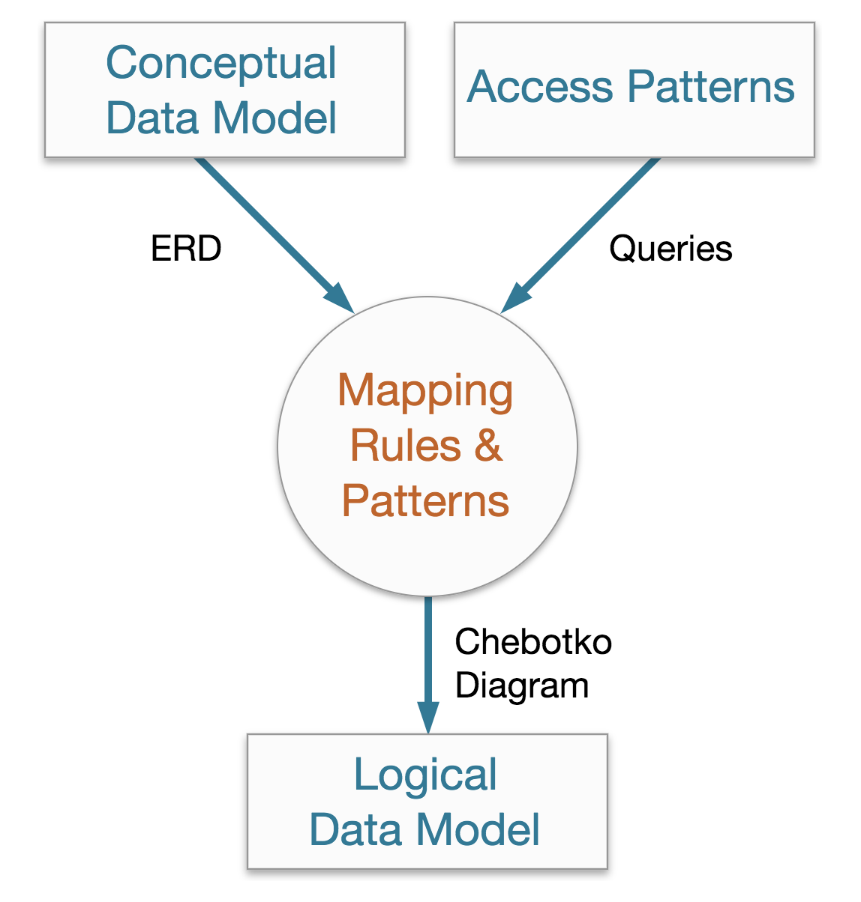
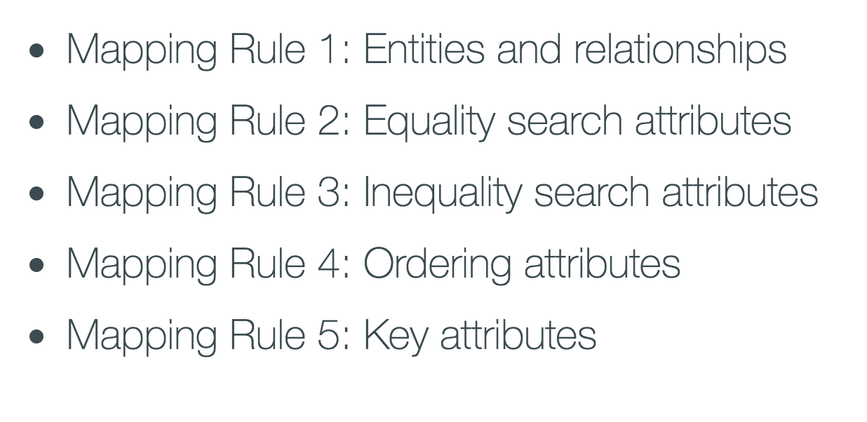
Mapping Conceptual to logical

Slide 31
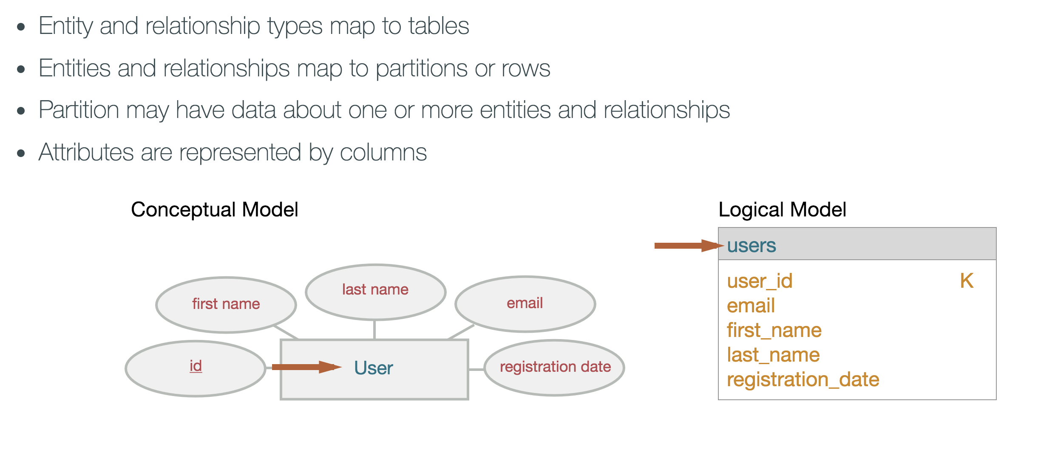
MR1 : Entities and Relationships

Slide 32
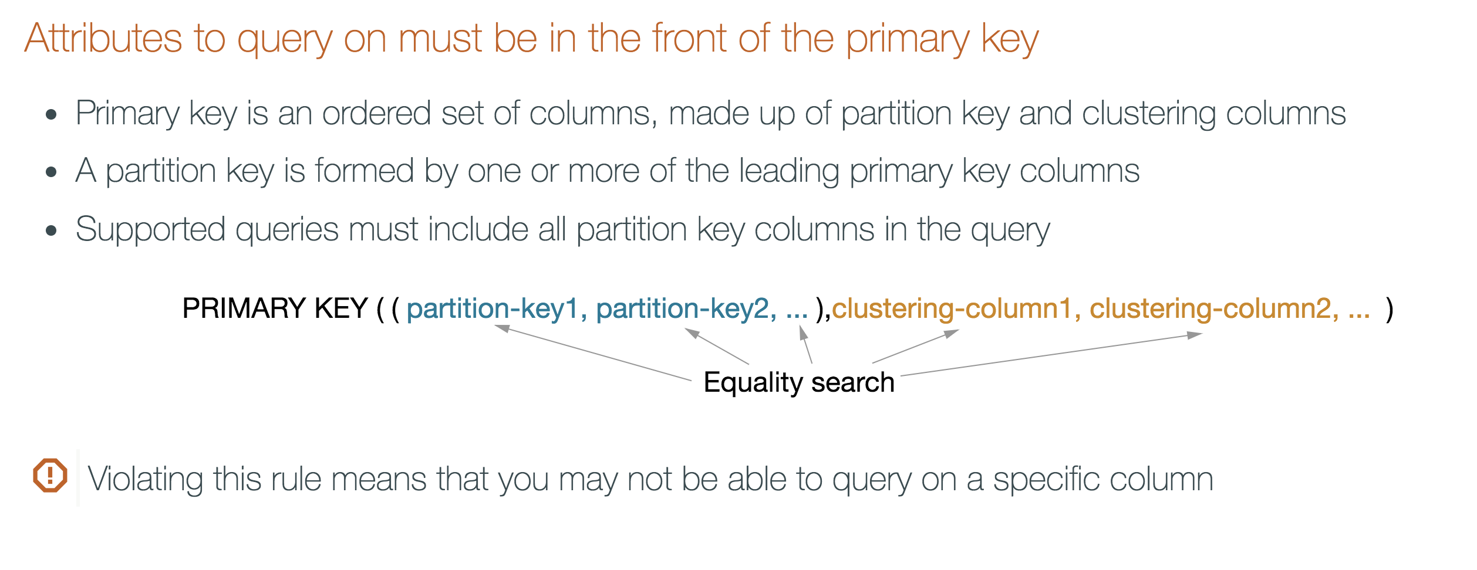
MR2: Equality Search Attributes

Slide 33
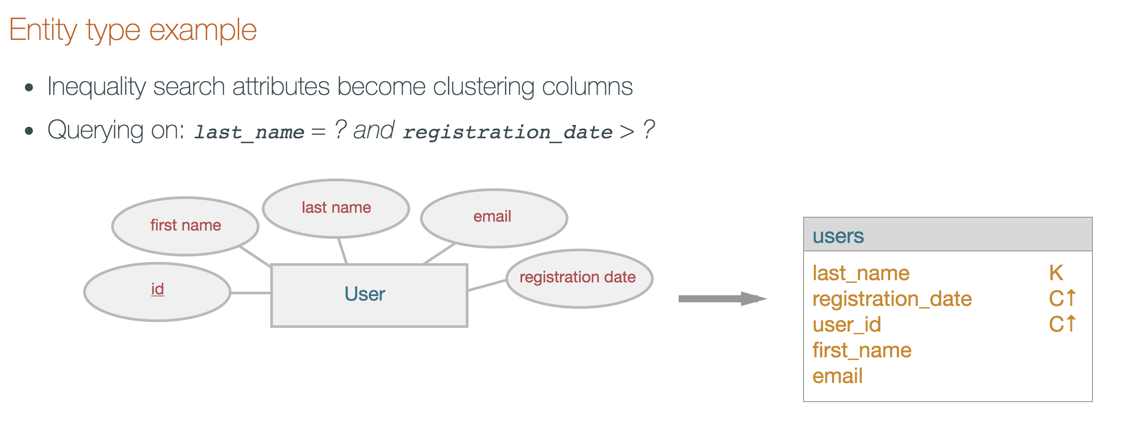
MR3: Inequality Search Attributes

Slide 34
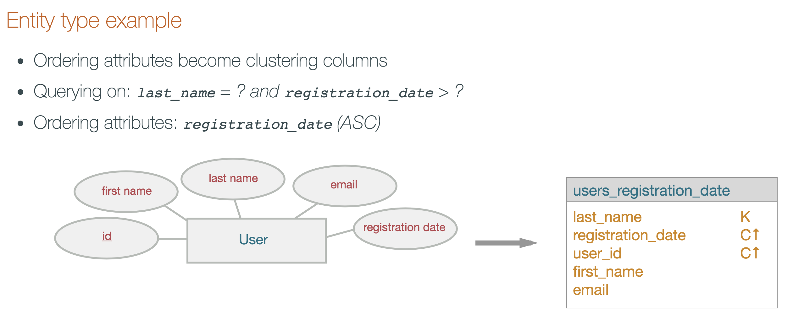
MR4: Ordering Attributes

Slide 35
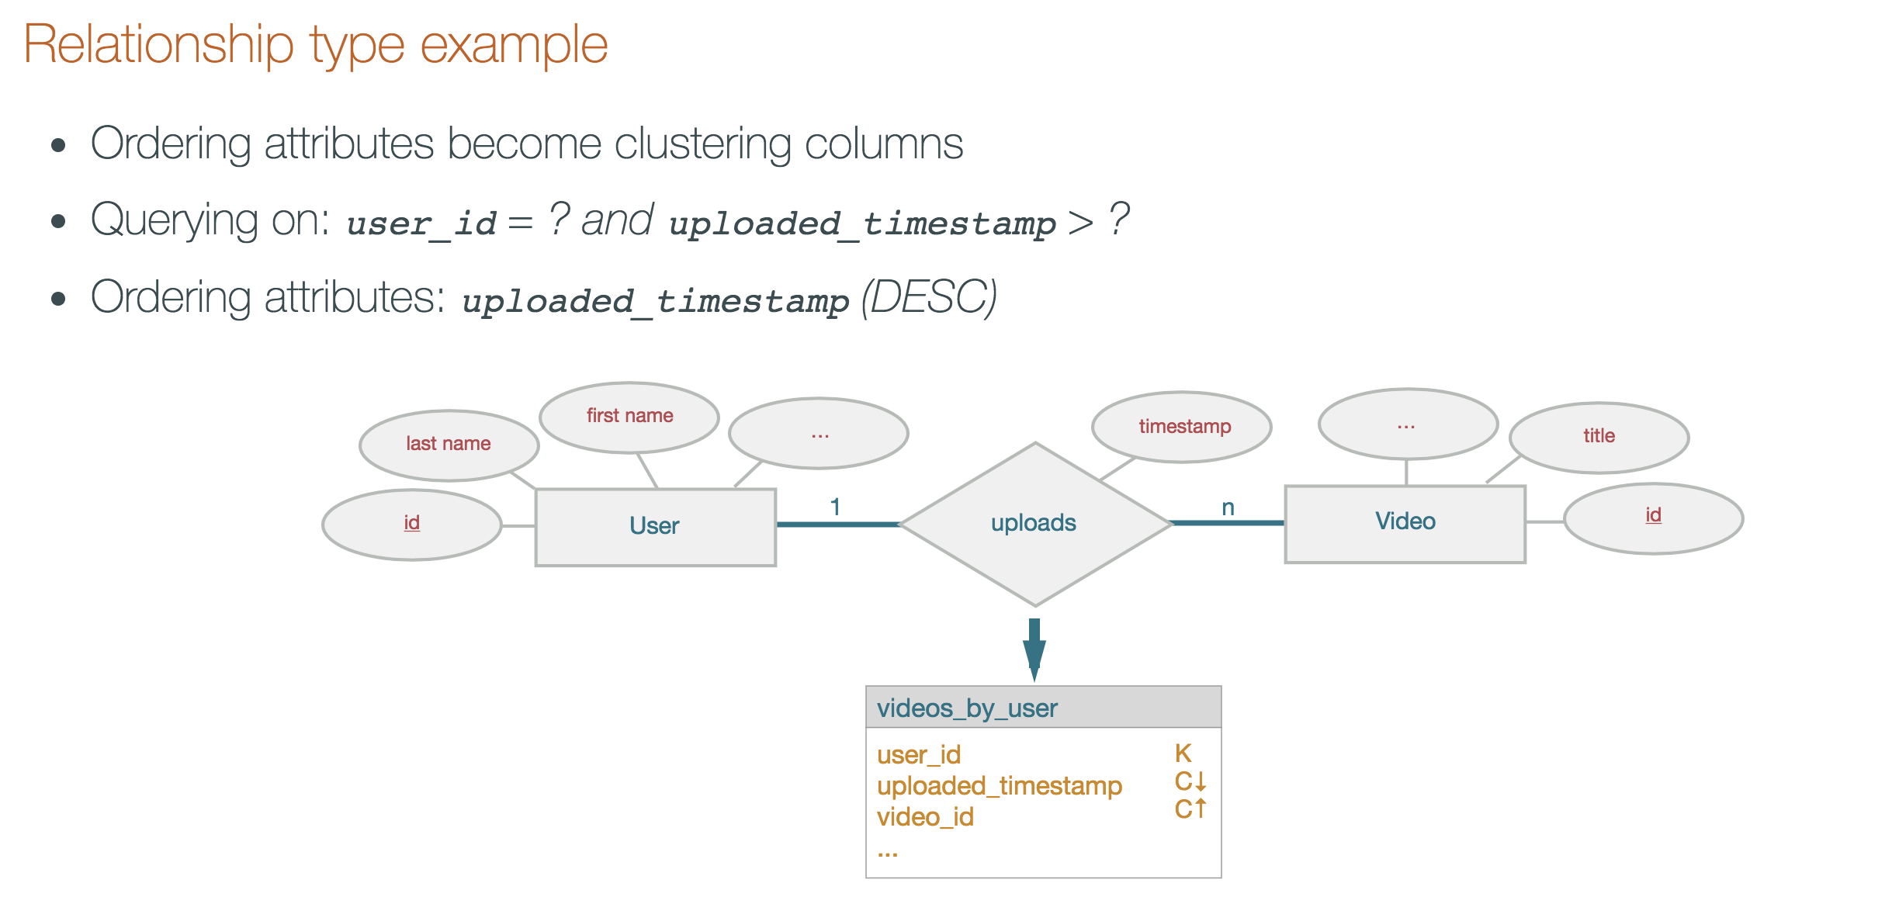
MR4: Ordering Attributes

Slide 36
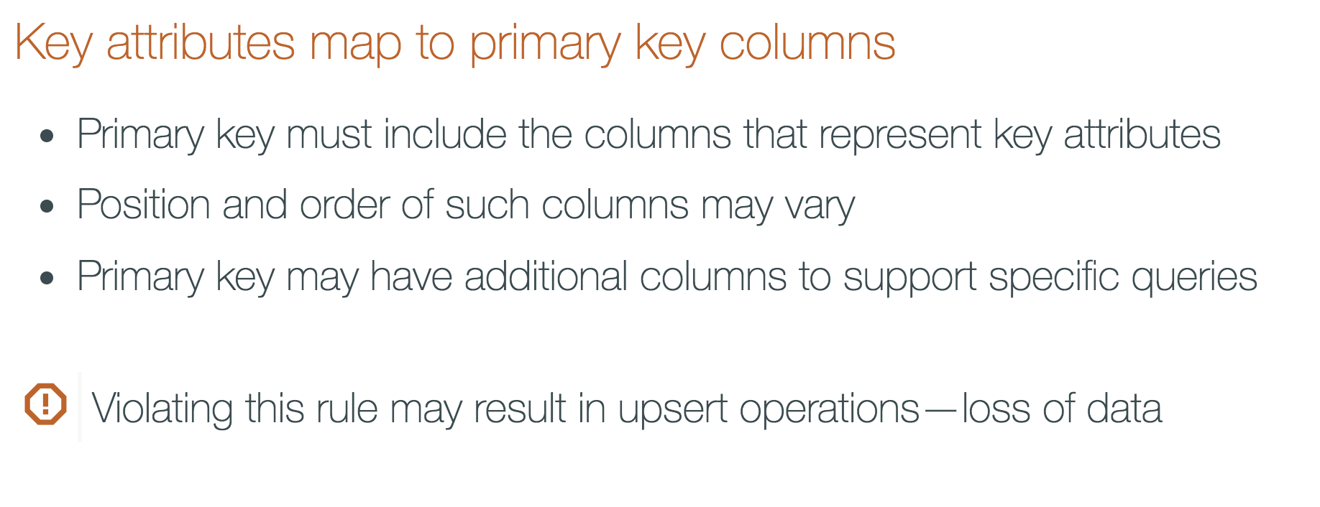
MR5: Key Attributes

Slide 37
Skinny vs. Wide rows
Compound Partition Key
PRIMARY KEY ((target_user,day), notification_time)
Number cells per partition (2 billion max.)
Faster operations and lower latency
multiple gets per dataset if needed
Equality select
SELECT * FROM notification where target_user =‘mike’ AND day IN (1,2,3);
Multiple Clustering Columns
PRIMARY KEY ((target_user), day, notification_time)
Simulates 1-N relation ship
wide rows
Range selects
SELECT * FROM notification where target_user =‘mike’ AND day IN (1,2,3);
Notes:
I need to insert 60GB of data into cassandra per day.
This breaks down into 100 sets of keys 150,000 keys per set 4KB of data per key
In terms of write performance am I better off using 1 row per set with 150,000 keys per row 10 rows per set with 15,000 keys per row 100 rows per set with 1,500 keys per row 1000 rows per set with 150 keys per row
Another variable to consider, my data expires after 24 hours so I am using TTL=86400 to automate expiration
More specific details about my configuration:
CREATE TABLE stuff ( stuff_id text, stuff_column text, value blob, PRIMARY KEY (stuff_id, stuff_column) ) WITH COMPACT STORAGE AND bloom_filter_fp_chance=0.100000 AND caching='KEYS_ONLY' AND comment='' AND dclocal_read_repair_chance=0.000000 AND gc_grace_seconds=39600 AND read_repair_chance=0.100000 AND replicate_on_write='true' AND populate_io_cache_on_flush='false' AND compaction={'tombstone_compaction_interval': '43200', 'class': 'LeveledCompactionStrategy'} AND compression={'sstable_compression': 'SnappyCompressor'}; Access pattern details: The 4KB value is a set of 1000 4 byte floats packed into a string.
A typical request is going to need a random selection of 20 - 60 of those floats.
Initially, those floats are all stored in the same logical row and column. A logical row here represents a set of data at a given time if it were all written to one row with 150,000 columns.
As time passes some of the data is updated, within a logical row within the set of columns, a random set of levels within the packed string will be updated. Instead of updating in place, the new levels are written to a new logical row combined with other new data to avoid rewriting all of the data which is still valid. This leads to fragmentation as multiple rows now need to be accessed to retrieve that set of 20 - 60 values. A request will now typically read from the same column across 1 - 5 different rows.
Test Method I wrote 5 samples of random data for each configuration and averaged the results. Rates were calculated as (Bytes_written / (time * 10^6)). Time was measured in seconds with millisecond precision. Pycassa was used as the Cassandra interface. The Pycassa batch insert operator was used. Each insert inserts multiple columns to a single row, insert sizes are limited to 12 MB. The queue is flushed at 12MB or less. Sizes do not account for row and column overhead, just data. The data source and data sink are on the same network on different systems.
Write results Keep in mind there are a number of other variables in play due to the complexity of the Cassandra configuration. 1 row 150,000 keys per row: 14 MBps 10 rows 15,000 keys per row: 15 MBps 100 rows 1,500 keys per row: 18 MBps 1000 rows 150 keys per row: 11 MBps

Slide 38
Basic Approach to Data Modeling
What queries are needed in your app?
What are your natural unique keys?
Is there ordering of the data needed to serve each query?
What are the groupings (1:M, M:M) in the data?
What filtering will your queries need?
Can events be stored in chronological order?
Does the data expire? Do large chunks of data expire together?
Notes:
Explain why it’s important to get the data model correct and let the students know about training and support from their local SE’s to vet their data models.

Slide 39
Agenda

Slide 40
Thank you

